Slide 1









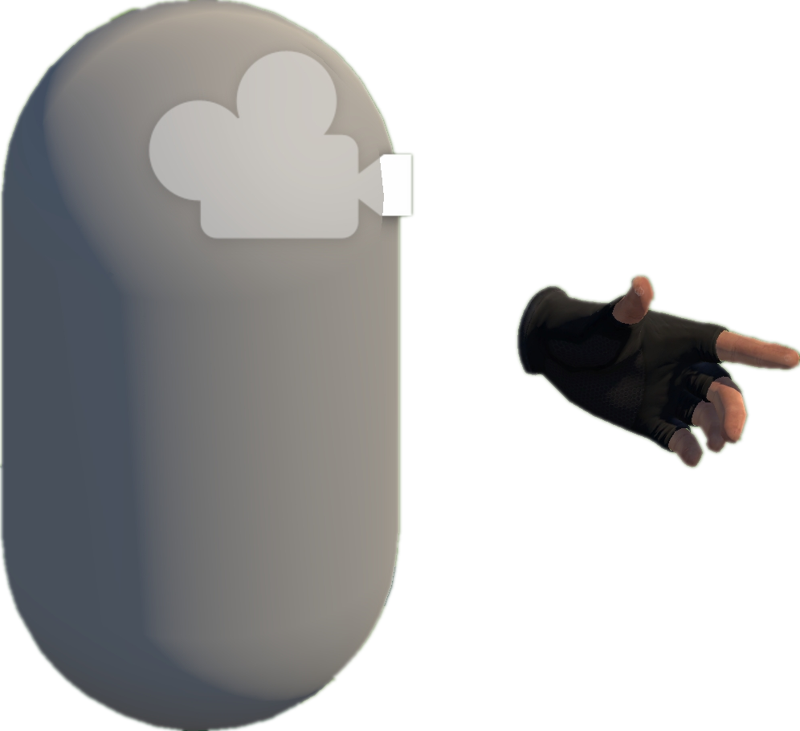

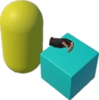




Project Collection
& Analysis (§ III-A)
C
EAT Framework (§ III-C)
A
Task Generator & Customized Task Model
Task Layer
Entity Interface
C# Scripts File
Open Source
Repositories
Collect By Tags
Action Layer
Unity Scene
GameObjects
Parallel and serial combinations
Entity Layer
Unity-based
VR Projects
Base Action
Mono Scripts
Third Plugins
NavMesh Data
Static Analysis
Inherit
Inherit
Environment
Grab Action
Trigger Action
Interactables
Trigger
S1. Scene/prefab scan
Box
Grab
Base Entity
Inherit
Inherit
S2. Script binding extraction
Grabbable Entity
Triggerable Entity
3
Behavior Execution and Scene Exploration
S3. Interaction pattern identification
Camera
Dynamic Analysis
Implement
Implement
Implement
XR Box
XR Joystick
XR Button
Hand Controller
Grab-And-Drag-Box Task
D1. Runtime state observation
Collider
Parallel Action
VRExplorer Agent
Move to Approcach
D2. Interaction flow tracing
D
VRExplorer Testing (§ III-D)
Move Action
Grab Action
Interaction & Scene Analysis
Grab
Move Action
D3. Heuristic validation of task logic
Preliminary Scene Configuration
PFSM
Autonomous Event Invocation
Asynchronous Action
1
Walk Around
Task Execution
Output the heuristic rules & experiences
Bake NavMesh
Original Scene
Scene with NavMesh (for navigation)
Decision Making
Abstraction of Actions
B
Model Abstraction (§ III-B)
Task Execution
Autonomous
Event Invocation
Press
Pressing
All Scripts
2
Implementation Interface
Input Next
Interactable’s Mono
Pressed
Trigger Action
+ Triggering Time
+ Triggering() + Triggered()
Heuristic rules & experiences
Researchers extract
the abstraction model
Customizing Entity Interface Configuration
Pull
Pulling
Core Scripts
Scripts Implemented
Entity Interface
Output
Task
Model
Relaxed
Task Generator
Fire
Pulling the trigger
Abstract Models
Triggered
Abstraction of Interactable Objects
Triggerable
Button, Joystick
Triggerable & Grabbable
Gun, Cigarette Lighter
Grabbable
Box, Coin
Notes:
单击此处添加文本

